Slide 1
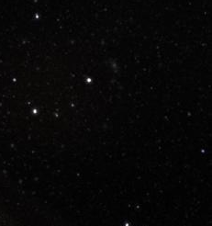
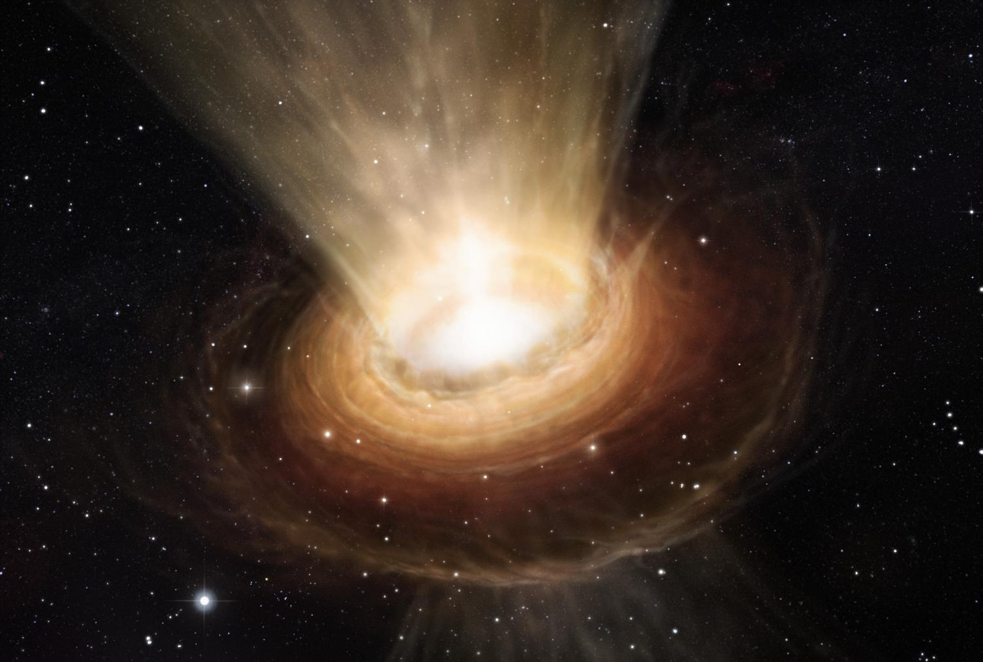
The Hunt for the First
Black Holes in the Universe
Fabio Pacucci
Yale University
In collaboration with:
Nico Cappelluti
Andrea Ferrara
Priyamvada Natarajan
Angelo Ricarte
Meg Urry
Marta Volonteri
Yale's Society of Physics Students
Yale University, New Haven (USA), 23 June 2017
Notes:
Today we are going on a journey together. I will ask you for about half an hour of your time to bring you literally to the other side of the Universe, to meet the first black holes that formed over there. Some parts of the journey will be very easy to understand, some others a little more complicated. Anyway, as your private tour guide, I feel the obligation to tease you a little about the final destination of our journey. The answers to these questions will be disclosed during the talk and they are the only 3 very important things that I would like you to retain from this journey.

Slide 2
Our Final Destination
When did the first black holes form?
Why are they important for the cosmic evolution?
Did they form as all the other black holes?
How do we find them?

Slide 3
Outline
TRAILER: WHAT IS A BLACK HOLE?
INTRODUCTION: THE FIRST BLACK HOLES
THE CODE: GEMS (Growth of Early Massive Seeds)
THE SPECTRUM OF THE FIRST BLACK HOLES
THE DETECTION OF THE FIRST BLACK HOLES
Notes:
This is a very general outline of my presentation. After the introduction on the first black holes and a brief description of the code that I developed, I will enter in the two fundamental sections of my talk, related to the analysis of the spectrum of the first black holes and the possibility of detecting them, with particular regard to HST and JWST.

Slide 4
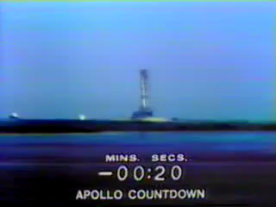
TRAILER
The Escape Velocity
The escape velocity from a celestial body is the minimum velocity required for another body to leave its gravitational field.
APOLLO 11 Launch - July 16, 1969

Slide 5
TRAILER
Astrophysical Black Holes
An astrophysical black hole is an object whose escape velocity is equal or higher than the speed of light.
At the event horizon:
Astrophysical black holes are defined by:
Mass
Spin
Charge

Slide 6
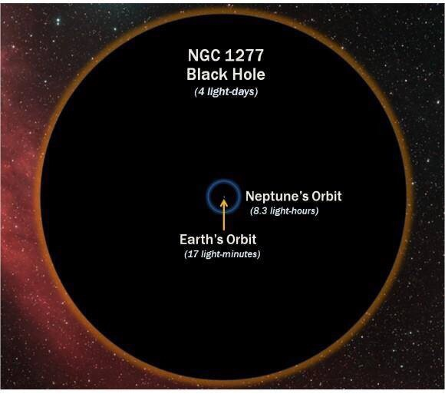
TRAILER
The Mass of a Black Hole
The mass is the main physical parameter to describe a black hole
Mass Determines:
spatial extension
category
Schwarzschild radius
Innermost Stable Circular Orbit

Slide 7
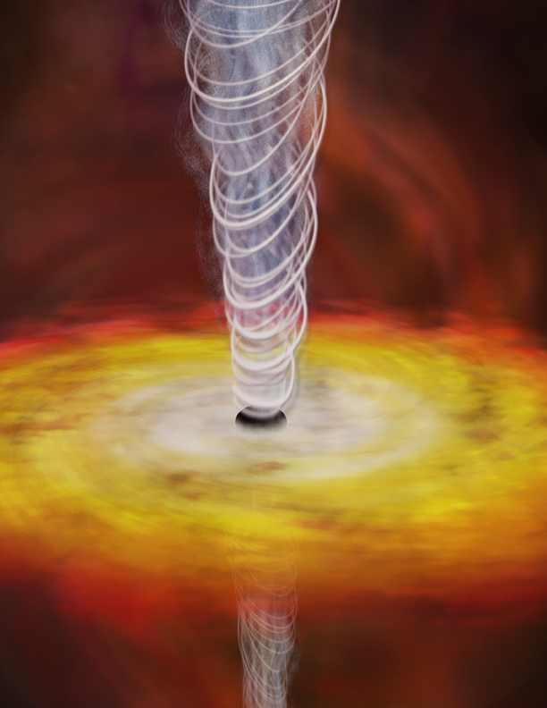
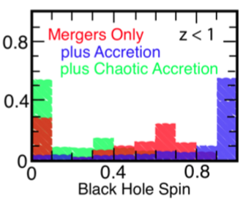
TRAILER
The Spin of a Black Hole
Astrophysical black holes may have a preferred rotation axis (Kerr’s solution)
Define the amount of angular momentum J via a dimensionless spin parameter:
a = 1 for a maximally rotating Kerr black hole
Measuring spins is hard!
Observed distribution for local black holes

Slide 8
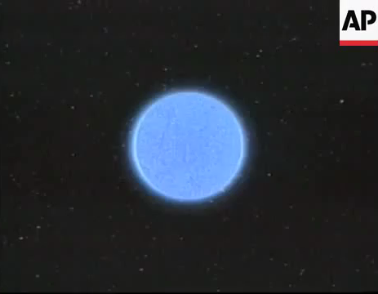
TRAILER
The Spin of a Black Hole

Slide 9
TRAILER
Black Holes… Shine!
Black holes do not emit from the inside of the event horizon.
The environment around them are among the most luminous in the Universe.
Emitted luminosity:

Slide 10
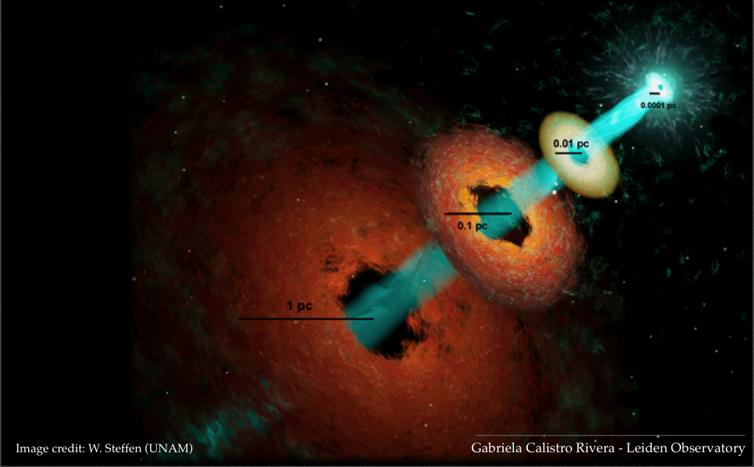
TRAILER
Black Holes Shine at Several Scales!
X-RAY
UV/OPT
INFRARED
RADIO

Slide 11
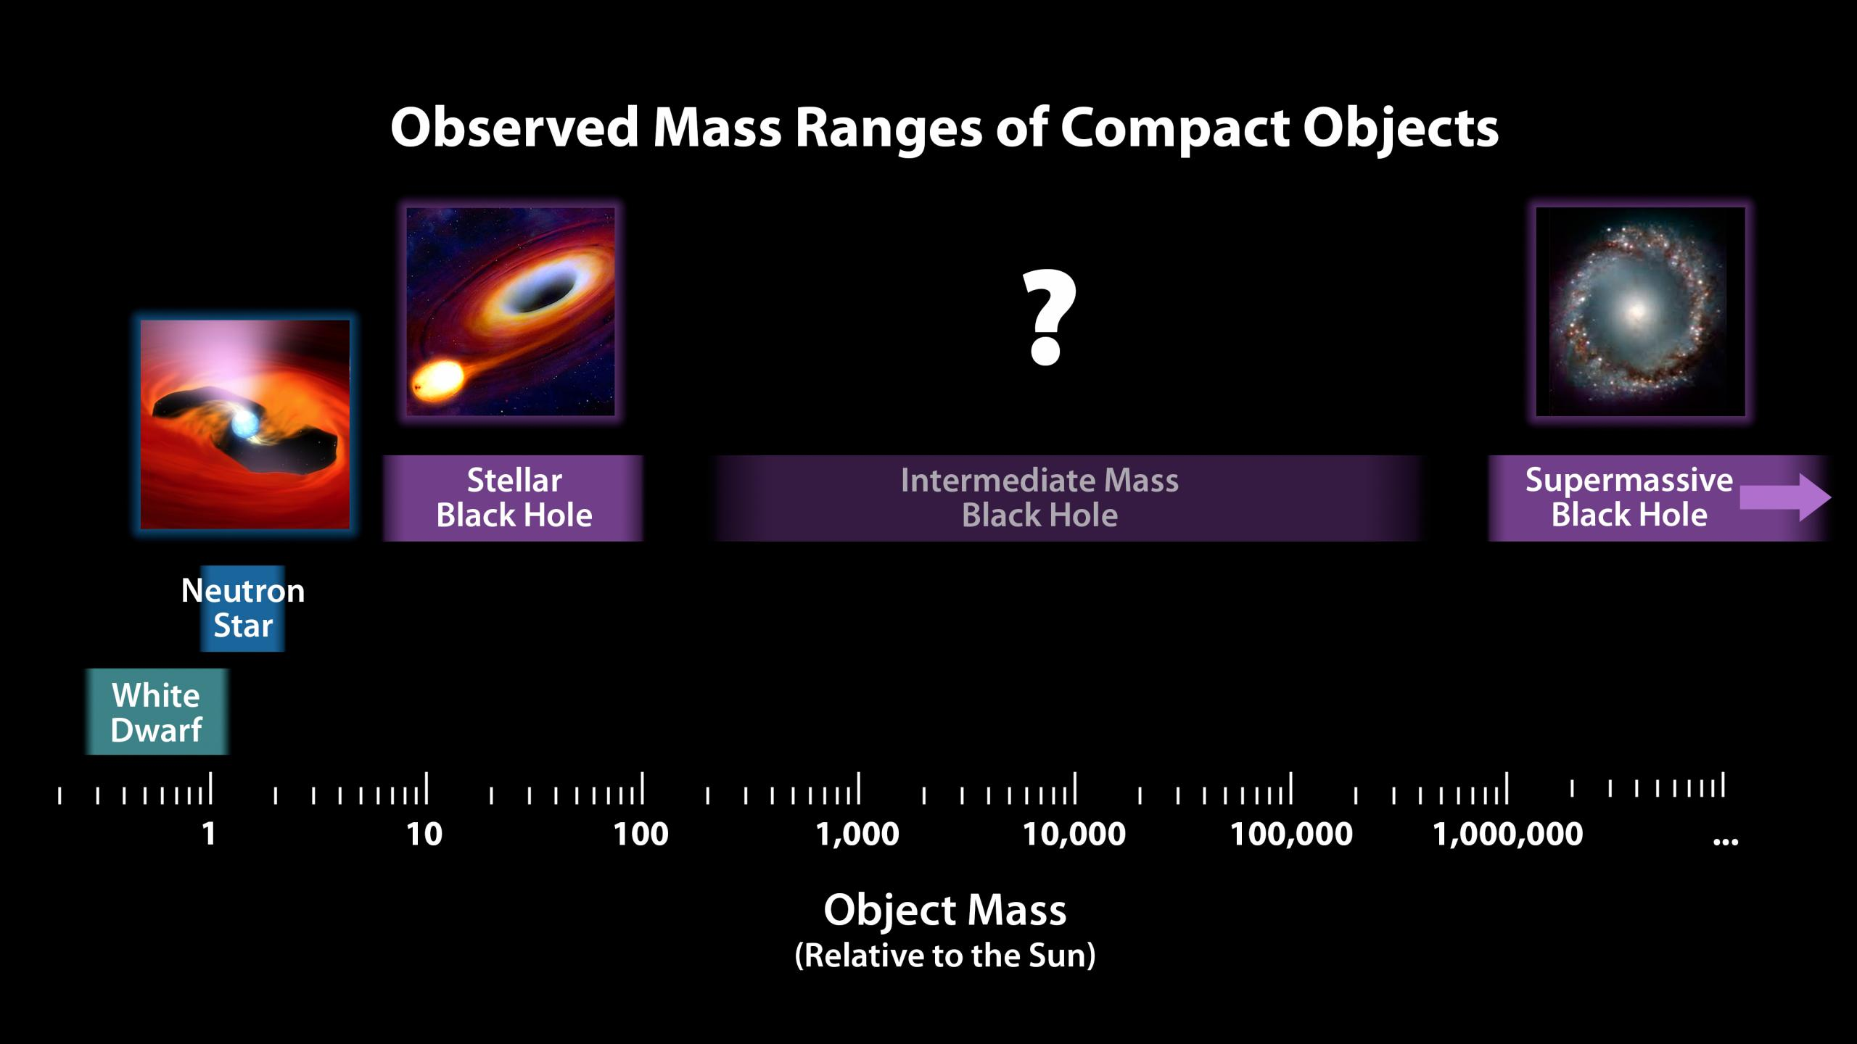
TRAILER
Black Holes Family Portrait
This growth process requires a long time…
This is the standard
formation channel
SMBHs are found at
the center of galaxies

Slide 12
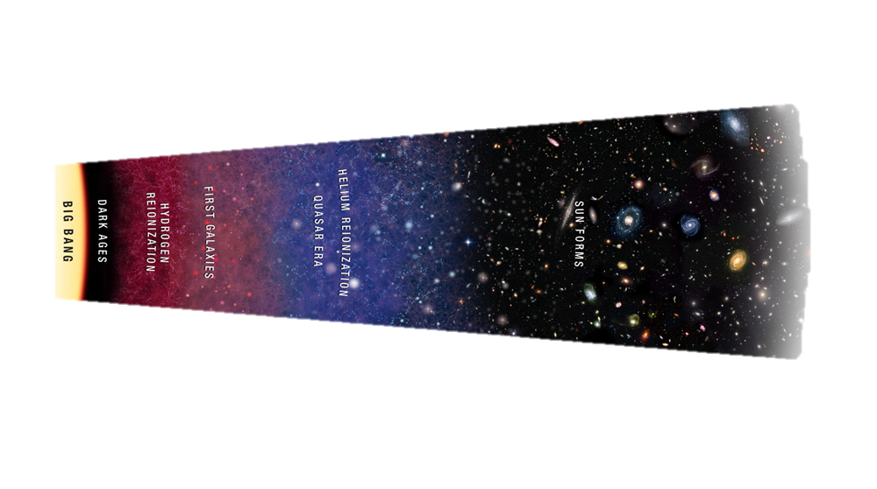
INTRODUCTION
“A Brief History of Time”
TIME
The seeds of the first SMBHs were formed here
First SMBHs
(1 Gyr)
Peak of black hole
activity (2 Gyr)
Now (13.7 Gyr)
Notes:
Let’s start from a little background, with a brief history of time. This cartoon shows a summary of the history of the Universe, with time increasing from left to right. From the Big Bang at the beginning of time, the Universe sees the occurrence of many events, leading it the the current state, about 13.7 billion years after the Big Bang. For our purposes, three events are particularly important, here about 2 billion years after the Big Bang, when most of the quasars are observed, and here, about 1 billion years after the Big Bang, when the first super-massive black holes are observed. The seeds of the first SMBHs were formed here, in the dark ages, the period of time preceding the cosmic reionization. But why do we care about the first black holes formed in the Universe? For at least a couple of reasons.

Slide 13
Waypoint #1
When did the first black holes form?
The first black holes formed when
the Universe was younger than 500 million years.

Slide 14
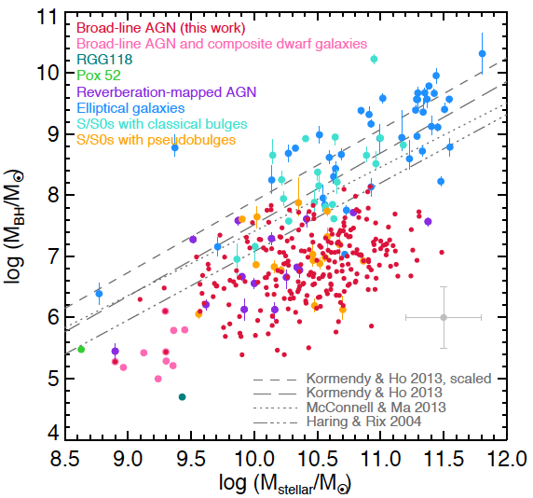
INTRODUCTION
Black Holes and Galaxies
(Reines et al., 2015)
Notes:
Second, the most massive black holes have contributed significantly to the formation and evolution of galaxies, the building blocks of our Universe. At the center of almost every galaxy there is a super-massive black hole weighting millions or billions of solar masses. There is strong evidence that these super-massive objects co-evolved with their host galaxies. In fact, there is a plethora of relations connecting the mass of the black hole to the physical or astrophysical properties of its host galaxy. For instance in this plot, taken from a recent review by Reines, there is a clear relation between the black hole mass and the stellar mass of the galaxy. Understanding how these super-massive objects formed will also help in understanding how the galaxies formed.

Slide 15
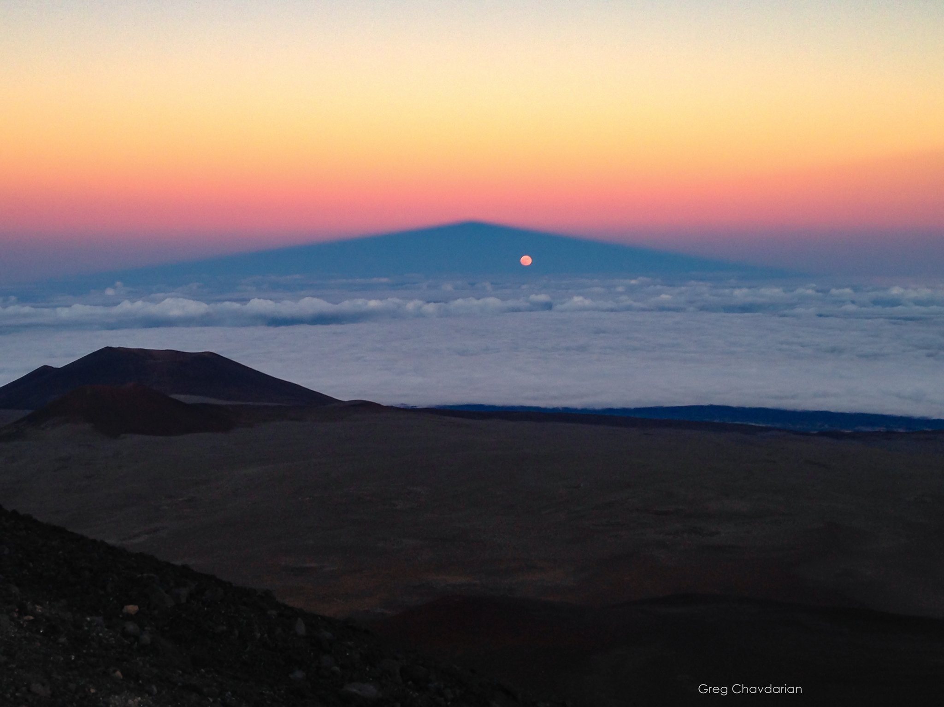
INTRODUCTION
The Building Blocks of the Universe
Notes:
Second, the most massive black holes have contributed significantly to the formation and evolution of galaxies, the building blocks of our Universe. At the center of almost every galaxy there is a super-massive black hole weighting millions or billions of solar masses. There is strong evidence that these super-massive objects co-evolved with their host galaxies. In fact, there is a plethora of relations connecting the mass of the black hole to the physical or astrophysical properties of its host galaxy. For instance in this plot, taken from a recent review by Reines, there is a clear relation between the black hole mass and the stellar mass of the galaxy. Understanding how these super-massive objects formed will also help in understanding how the galaxies formed.

Slide 16
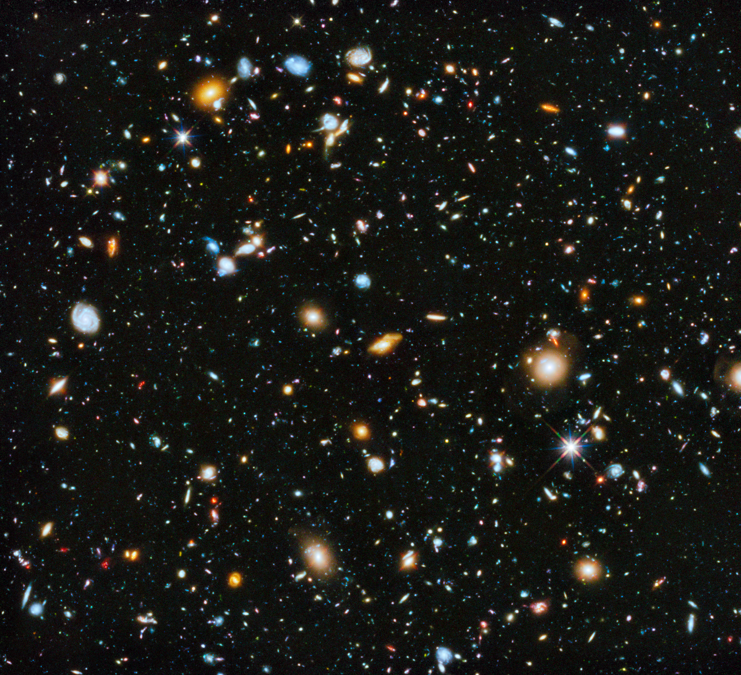
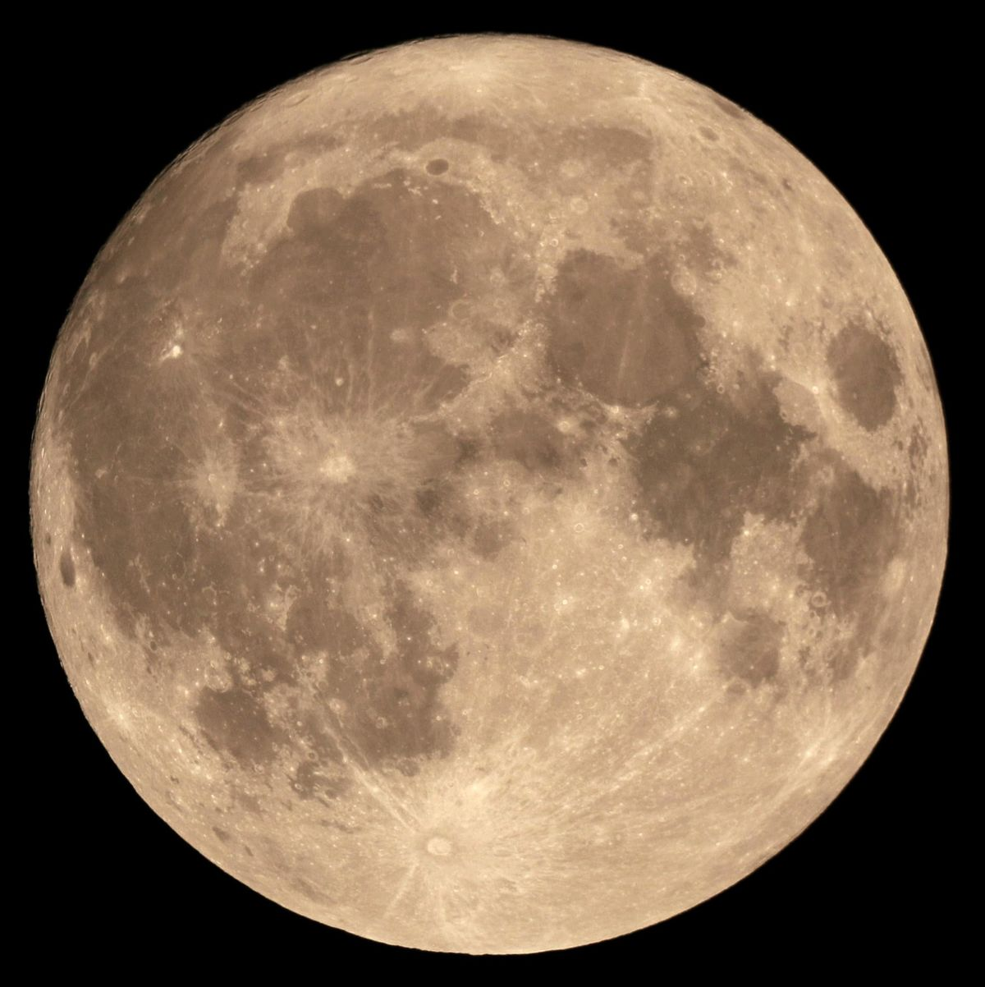
INTRODUCTION
The Building Blocks of the Universe
Notes:
Second, the most massive black holes have contributed significantly to the formation and evolution of galaxies, the building blocks of our Universe. At the center of almost every galaxy there is a super-massive black hole weighting millions or billions of solar masses. There is strong evidence that these super-massive objects co-evolved with their host galaxies. In fact, there is a plethora of relations connecting the mass of the black hole to the physical or astrophysical properties of its host galaxy. For instance in this plot, taken from a recent review by Reines, there is a clear relation between the black hole mass and the stellar mass of the galaxy. Understanding how these super-massive objects formed will also help in understanding how the galaxies formed.

Slide 17
Waypoint #2
Why are they important for the cosmic evolution?
Understanding the first black holes
is important because
they played a key role in galaxy formation.

Slide 18

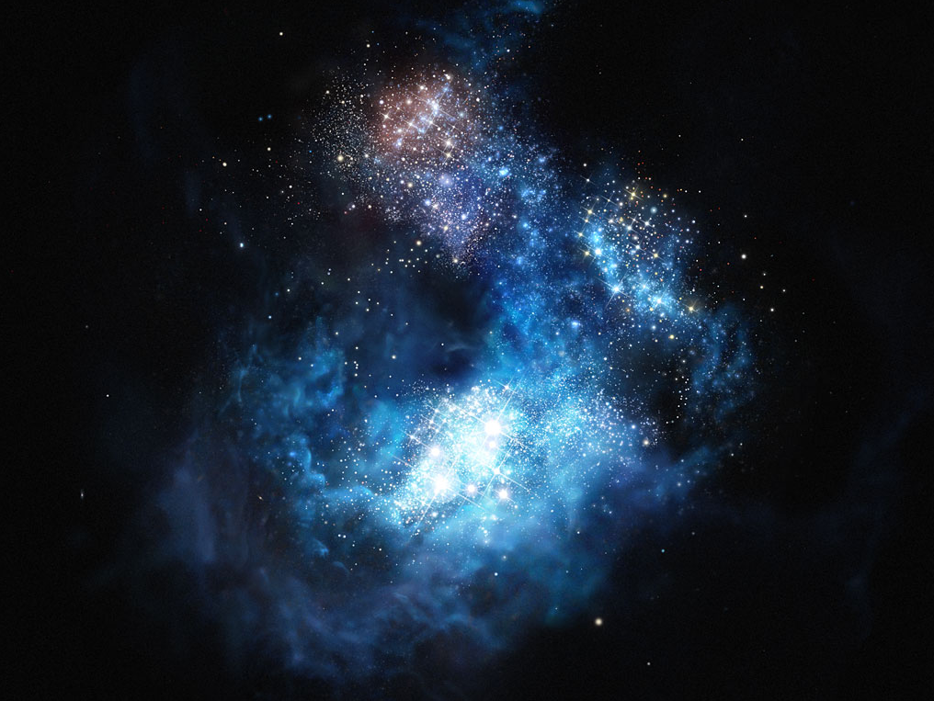
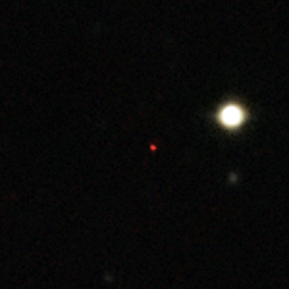
INTRODUCTION
The Billion (Dollar) Problem
Observations of SMBHs < 1 billion years after the Big Bang
How did they grow up so rapidly?
STELLAR SEED
ULAS J1120+0641
z = 7.085
MASSIVE SEED
Notes:
One of the main problems that cosmology faces nowadays is related to the formation of the first supermassive black holes. Several observations suggest the presence of black holes with mass 1 billion or even 10 billion solar masses less than 1 billion years after the Big Bang. For the standard theory of black hole growth, so assuming a continuous Eddington-limited accretion, it is very challenging to build up such massive objects from a low-mass black hole seed, of hundreds solar masses, formed for instance by a Pop III star. Instead, if black hole seeds were more massive, with masses of order 10^4-5 solar masses, then it could have been possible to build up objects on the billion solar masses scale in just 500 Myr.

Slide 19


INTRODUCTION
A More “Terrestrial” Example
Some day
The day after
There must be a misunderstanding.
Notes:
Several mechanisms have been proposed to form these massive seeds already at redshift 10-15: the main ones are listed here. In our work we focus on the Direct Collapse Black Hole scenario.
The collapse of a metal-free, atomic-cooling halo may lead, with the presence of a strong Lyman-Werner flux to destroy the hydrogen molecules and prevent fragmentation, to the formation of DCBHs with typical mass of 10^5 solar masses. Inflow rates must be kept at high levels in order to have an isothermal collapse and avoid the formation of a super massive star. The black hole seed then finds itself at the center of a collapsing cloud of unpolluted gas, and its growth continues.

Slide 20
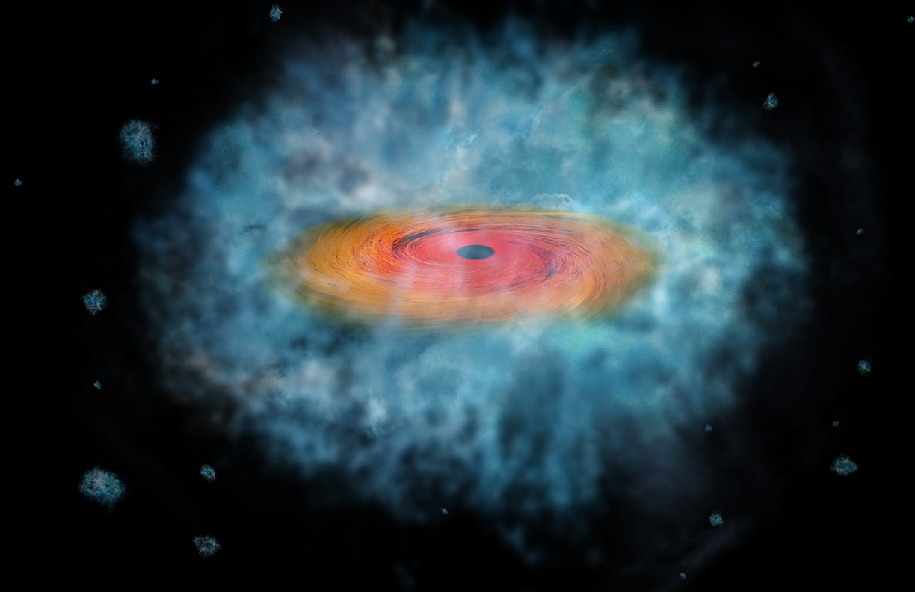
INTRODUCTION
Making a Massive Seed
Main proposed mechanisms:
Making a DCBH
Host halo & environment:
  Direct Collapse Black Hole
  (DCBH)
  Metal-free gas
  Direct Collapse Black Hole
  (DCBH)
  Atomic-cooling halo
  Gravitationally unstable
  disk in low-metallicity halo
  Strong Lyman-Werner
  (11.2 eV – 13.6 eV) flux
  Collisions in a Pop III cluster
  Large inflow rates
Notes:
Several mechanisms have been proposed to form these massive seeds already at redshift 10-15: the main ones are listed here. In our work we focus on the Direct Collapse Black Hole scenario.
The collapse of a metal-free, atomic-cooling halo may lead, with the presence of a strong Lyman-Werner flux to destroy the hydrogen molecules and prevent fragmentation, to the formation of DCBHs with typical mass of 10^5 solar masses. Inflow rates must be kept at high levels in order to have an isothermal collapse and avoid the formation of a super massive star. The black hole seed then finds itself at the center of a collapsing cloud of unpolluted gas, and its growth continues.

Slide 21

INTRODUCTION
Key Questions
THE SPECTRUM OF THE FIRST BLACK HOLES
What are the emission characteristics of DCBHs?
Dependence of the DCBH emission on accretion physics.
THE DETECTION OF THE FIRST BLACK HOLES
Are they observable by current and/or future observatories?
Survey strategies to find them: the role of HST and JWST
Our Approach:
Analytical + Numerical
Notes:
The two main parts of my talk translate into these key questions. What are the emission characteristics of DCBHs? What is the dependence of the DCBH emission on accretion physics? How is the spectrum emerging from highly-obscured galaxies? Are they observable by current and/or future observatories? What are the best strategies to find them? Blind wide field searches or targeted searches? What are the roles of the HST and the JWST telescopes in this searches? Could there possibly a synergy between them?
Our approach to tackle these questions is a combination of analytical methods and numerical simulations, performed with GEMS, a code specifically designed to investigate the accretion flow on the first black holes of the Universe.

Slide 22
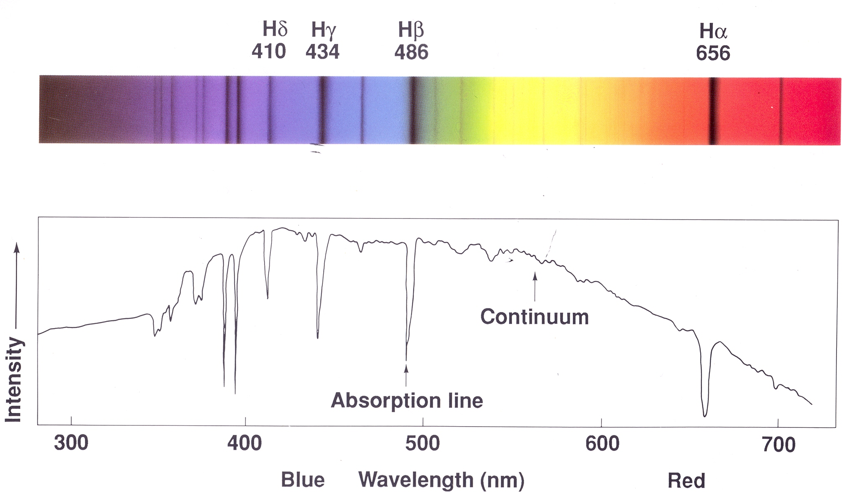
INTRODUCTION
Spectroscopy vs Photometry
A
B
COLOR = A/B
This star is blue!
Notes:
The previous plots were related to a standard model for the accretion disk. In highly-obscured environments, with extremely large absorbing column densities as the ones predicted for high-z black hole seeds, the situation is quite different. In fact, the spectral distribution of emitted photons changes, because in this case the X-ray photons are highly suppressed and the entire accretion process may become invisible to current X-ray surveys. Notwithstanding this, the infrared emission is enhanced so the JWST and marginally the HST should be able to detect these sources. Optical and infrared telescopes might be our only viable way to unravel highly-obscured black holes in the early Universe.

Slide 23
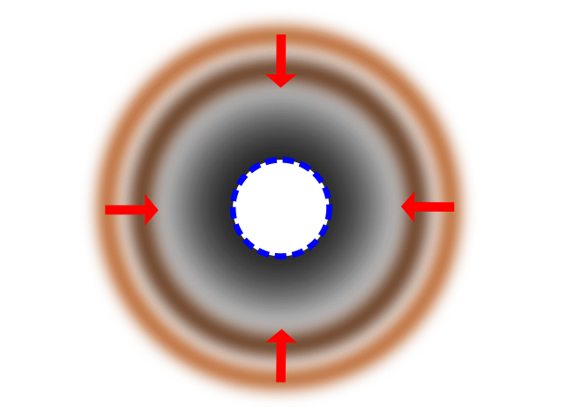
CODE
How to Study DCBHs?
Physical Framework:
Numerical Framework:
GEMS code
(Growth of Early Massive Seeds):
Spherical symmetry
Solves Euler’s equations
Solves Radiation Transfer
Cooling terms: atomic
Opacity terms: Thomson (main) and electronic transitions
(Pacucci & Ferrara, 2014)
We do not model the seed formation
Notes:
This is the general physical framework of our work. A high-redshift black hole seed with a given initial mass is located and already formed at the center of a dark matter halo with total mass around 10^8 solar masses, corresponding to a virial temperature of 10^4 K. We analyze the accretion process on scales comparable with the Bondi radius through a radiation/hydrodynamic code that we developed, named GEMS, which stands for Growth of Early Massive Seeds. Its main features are reported in this list. I do not have time to go into the technical details of the code, but I would be glad to discuss them with you if you are interested. Now just a few words to describe how we computed the spectrum of DCBHs.
We employed our hydrodynamic simulations and post-processed them with a spectral synthesis code, in order to compute the time-evolution of the spectrum emerging from the host halo.

Slide 24
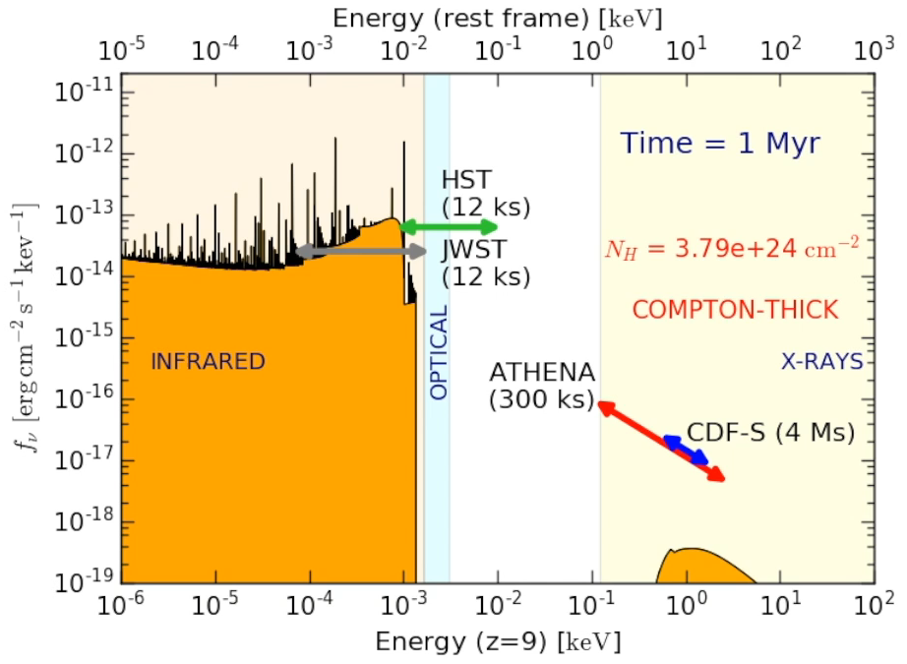
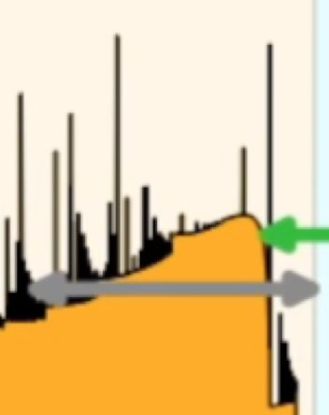
The Spectrum of a DCBH
SPECTRUM
Zero metallicity
Notes:
The time evolution of the spectrum emerging from the host halo is shown in this video, assuming a standard accretion scenario on a typical DCBH with a zero-metallicity gas. The two horizontal axes show the observer’s frame and the rest frame, while the vertical axis shows the flux density. On the right you can see the time in Myrs and the column density of the host halo. Most of the energy emerges in observed X-ray band and infrared band.
For a Compton-Thick gas, the continuum normalization in the infrared and in the X-rays increase with the bolometric luminosity of the source. When the gas becomes Compton-thin, the X-rays continuum rapidly increases, while the infrared one starts to decrease, because a smaller number of photons is reprocessed at lower energies. As can be seen from the flux thresholds shown, we predict that the JWST will be able to observe the entire accretion process, while ATHENA, and the CDF-S can only detect it around the peak luminosity. The HST is marginally able to observe these sources at frequencies close to the Lyman alpha line. If we zoom in into the near-infrared part of the spectrum, we are able to compare our spectral predictions with the JWST limits in the different photometric bands.

Slide 25
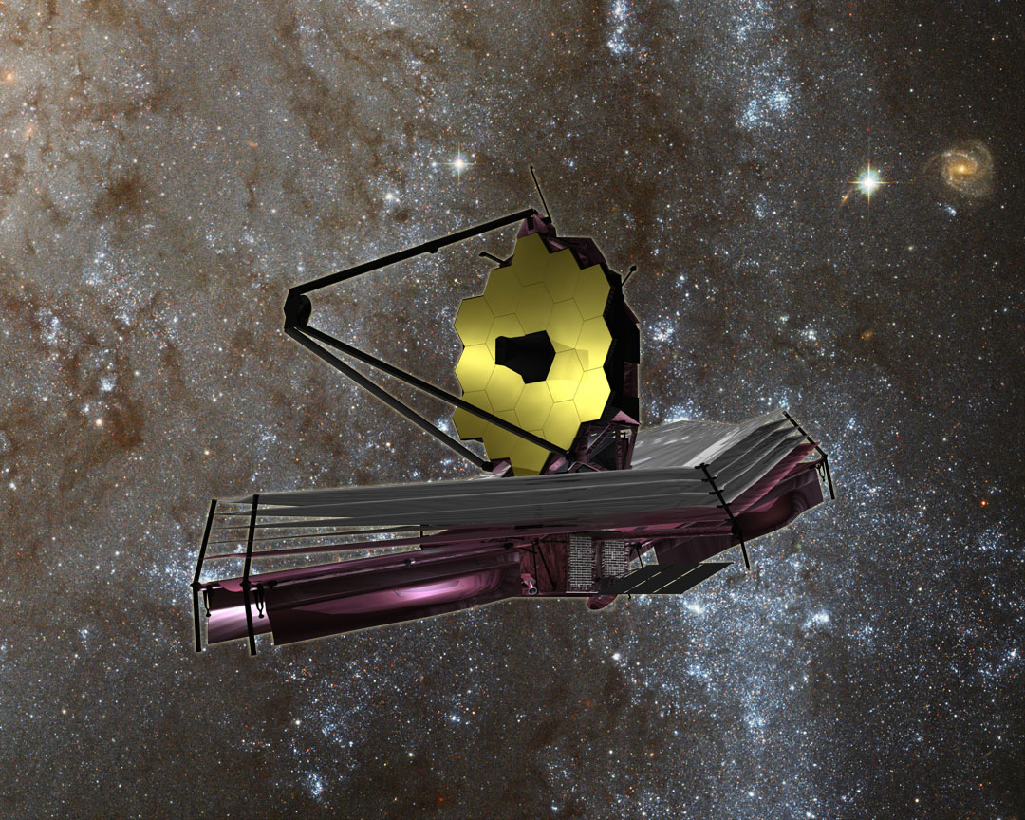
SPECTRUM
The James Webb Space Telescope
Scheduled Launch: October 2018 (fingers crossed…!)
Notes:
In this plot, the black symbols correspond to the MIRI and NIRCam filter band passes on JWST and the error bars denote the width of the filters. The red line corresponds to the infrared SED of a DCBH in the standard accretion model with zero metallicity, while the green line shows the SED in a low metallicity model, with is 10^-3 solar metallicity. The SED has been computed at the peak of the optical emission. As you can see, all our models for DCBH seeds should be observable by the JWST in the near infrared. The JWST will then be the primary instrument to look for black hole seeds in the early Universe, especially for its spectral capabilities. We also compared these SED with the ones of other high-z sources, a dusty old galaxy, an Extreme Emission Line Galaxy and a star forming galaxy. As you can see the infrared emission predicted in out SEDs is significantly larger.

Slide 26
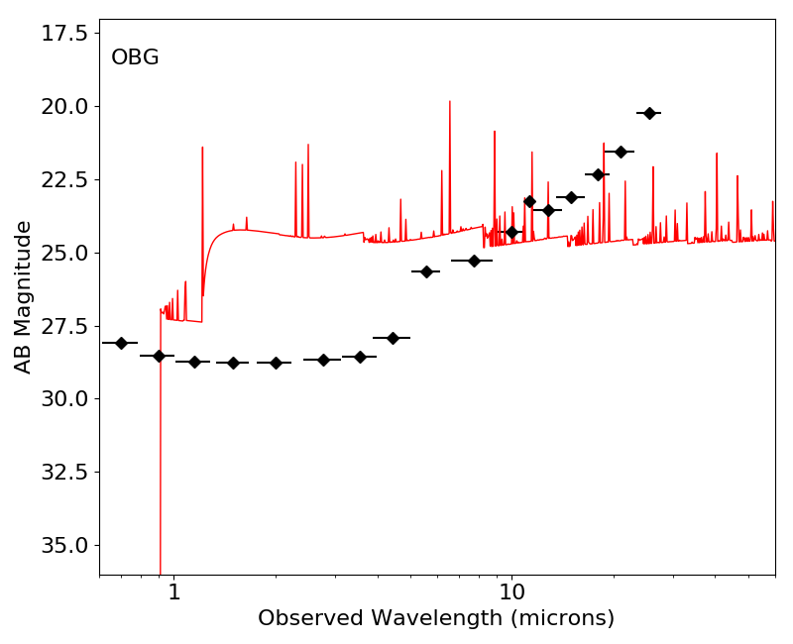
SPECTRUM
Detecting DCBHs with JWST
DCBH seeds
figure6a.pdf
Standard, Z=0
(Natarajan et al., 2016)
Notes:
In this plot, the black symbols correspond to the MIRI and NIRCam filter band passes on JWST and the error bars denote the width of the filters. The red line corresponds to the infrared SED of a DCBH in the standard accretion model with zero metallicity, while the green line shows the SED in a low metallicity model, with is 10^-3 solar metallicity. The SED has been computed at the peak of the optical emission. As you can see, all our models for DCBH seeds should be observable by the JWST in the near infrared. The JWST will then be the primary instrument to look for black hole seeds in the early Universe, especially for its spectral capabilities. We also compared these SED with the ones of other high-z sources, a dusty old galaxy, an Extreme Emission Line Galaxy and a star forming galaxy. As you can see the infrared emission predicted in out SEDs is significantly larger.

Slide 27
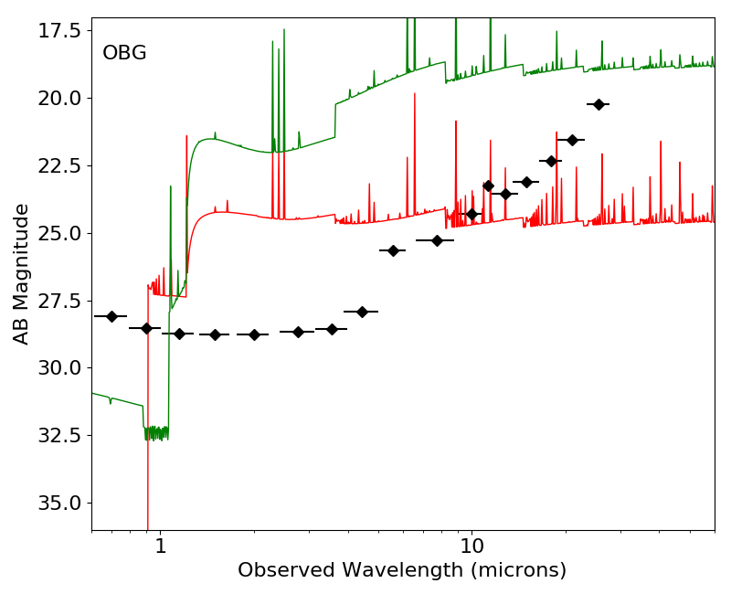
SPECTRUM
Detecting DCBHs with JWST
DCBH seeds
figure6a.pdf
Standard, low Z
Standard, Z=0
(Natarajan et al., 2016)
Notes:
In this plot, the black symbols correspond to the MIRI and NIRCam filter band passes on JWST and the error bars denote the width of the filters. The red line corresponds to the infrared SED of a DCBH in the standard accretion model with zero metallicity, while the green line shows the SED in a low metallicity model, with is 10^-3 solar metallicity. The SED has been computed at the peak of the optical emission. As you can see, all our models for DCBH seeds should be observable by the JWST in the near infrared. The JWST will then be the primary instrument to look for black hole seeds in the early Universe, especially for its spectral capabilities. We also compared these SED with the ones of other high-z sources, a dusty old galaxy, an Extreme Emission Line Galaxy and a star forming galaxy. As you can see the infrared emission predicted in out SEDs is significantly larger.

Slide 28
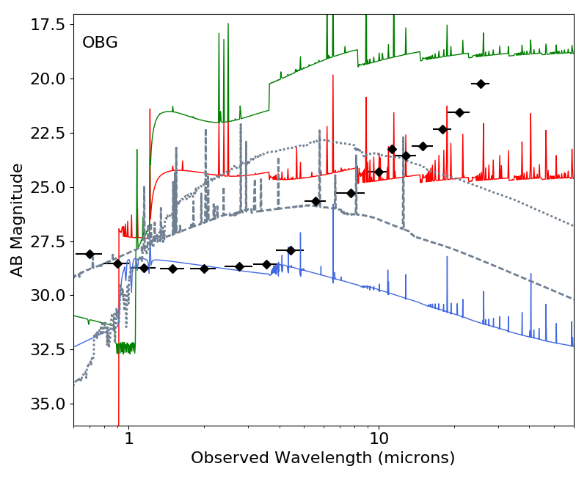
SPECTRUM
Detecting DCBHs with JWST
DCBH seeds
figure6a.pdf
Standard, low Z
Standard, Z=0
EELG
Dusty, old
Standard
SF galaxy
(Natarajan et al., 2016)
Notes:
If we zoom in into the near-infrared part of the spectrum, we are able to compare our spectral predictions with the JWST limits in the different photometric bands. Each line corresponds to a different DCBH model and the SED has been computed at the peak of the optical emission. As you can see, all our models for DCBH seeds should be observable by the JWST in the near infrared. The JWST will then be the primary instrument to look for black hole seeds in the early Universe, especially for its spectral capabilitiesIn this plot, the black symbols correspond to the MIRI and NIRCam filter band passes on JWST and the error bars denote the width of the filters. The red line corresponds to the infrared SED of a DCBH in the standard accretion model with zero metallicity, while the green line shows the SED in a low metallicity model, with is 10^-3 solar metallicity. The SED has been computed at the peak of the optical emission. As you can see, all our models for DCBH seeds should be observable by the JWST in the near infrared. The JWST will then be the primary instrument to look for black hole seeds in the early Universe, especially for its spectral capabilities. We also compared these SED with the ones of other high-z sources, a dusty old galaxy, an Extreme Emission Line Galaxy and a star forming galaxy. As you can see the infrared emission predicted in out SEDs is significantly larger.

Slide 29
Waypoint #3
Did they form similarly to the nearby black holes?
How do we find them?
The first black holes formed in a peculiar way
and we believe that they can be observed.

Slide 30
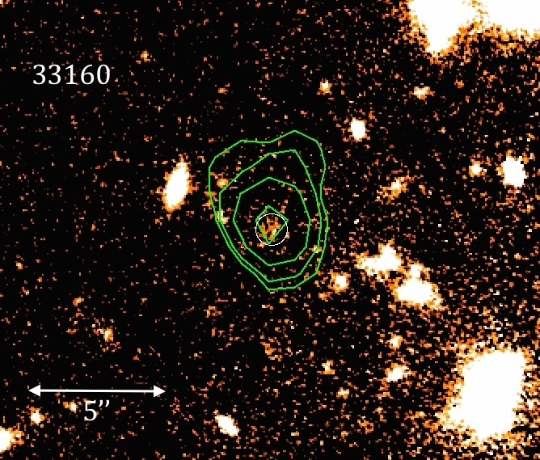
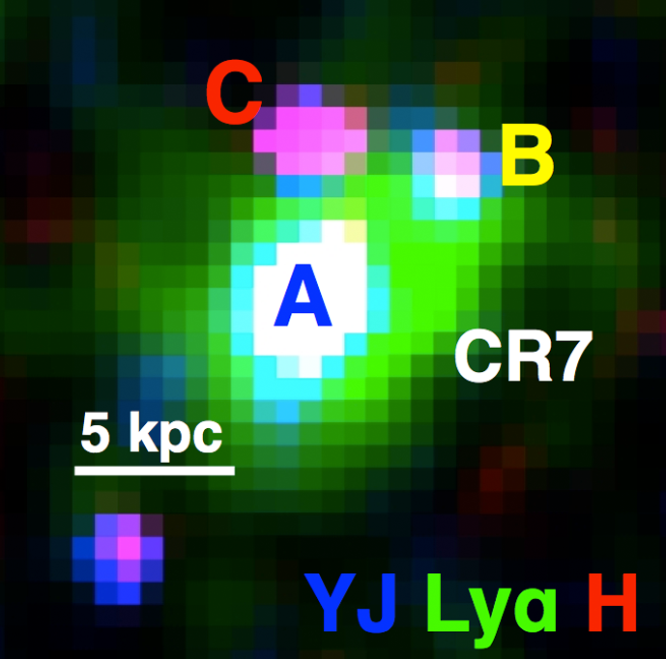
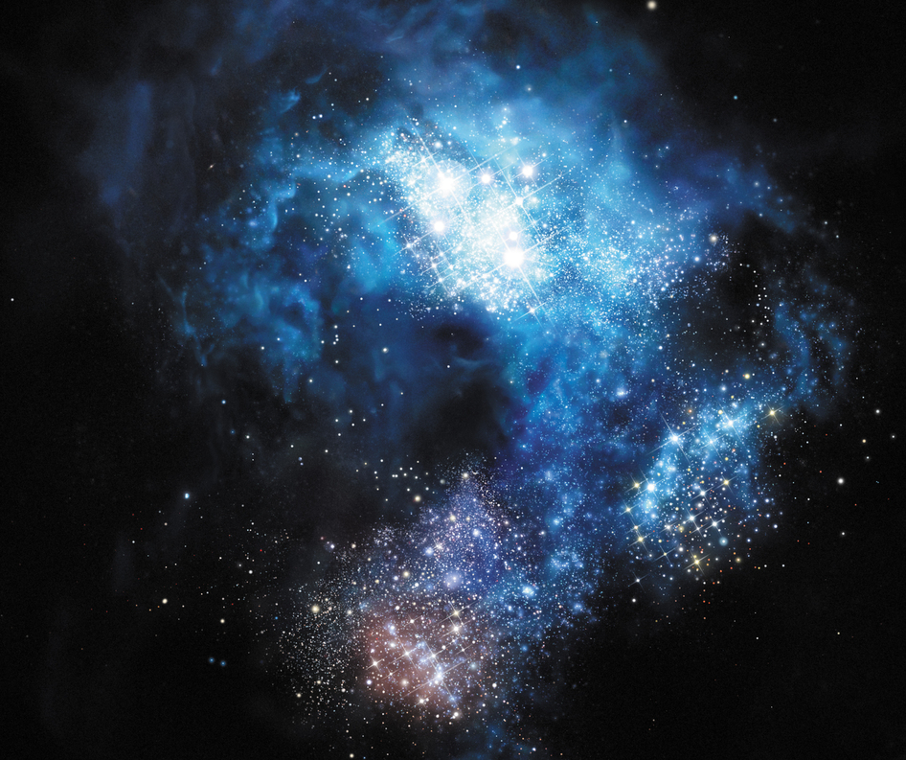
DETECTION
Status of Black Hole Seeds Searches
SURVEYS
Photometric selection
Two DCBH candidates in
GOODS-S at z>6
(Pacucci et al., 2016)
DCBH candidate at z = 6.06
SINGLE SOURCES
Pop III stars
DCBH
  The case of CR7 (LAE at z=6.6)
(e.g. Sobral et al., 2015):
  No metal lines
  Strong Lya and He II lines
  (but see Shibuya et al., 2017)
Notes:
Now I am going to focus the attention on the current status of our search for black hole seeds. It is reasonable to divide these searches into two categories. The first is a photometric selection of possible DCBH candidates in large-area surveys. These searches possibly identify a group of objects whose colors are compatible with the ones theoretically predicted for DCBHs, which need to be followed-up spectroscopically. I will present you the case of two high-z objects in the GOODS-S field.

Slide 31
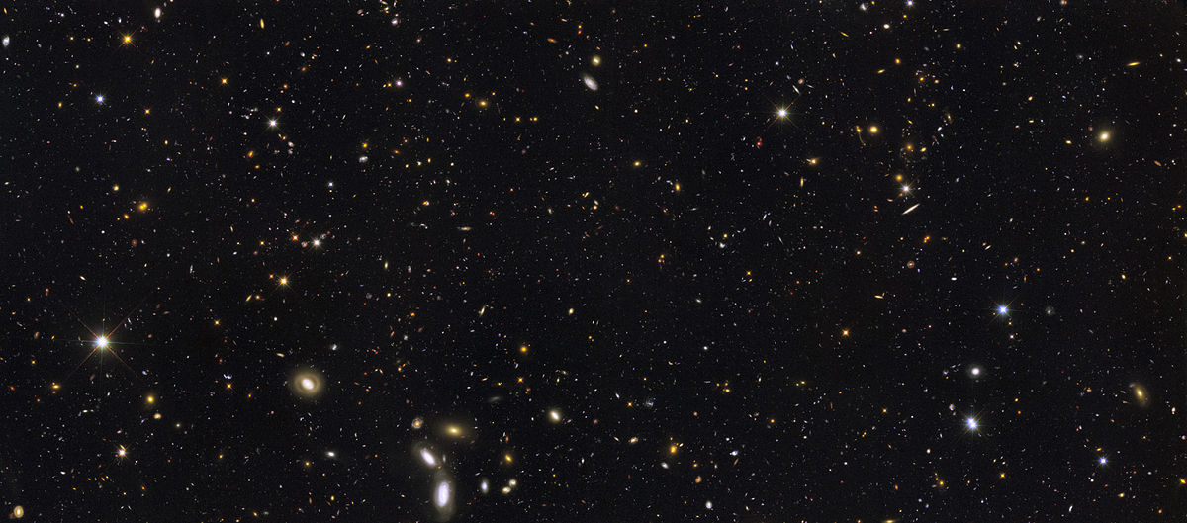
DETECTION
Photometric Searches
of the First Black Holes
Is this source a galaxy
or a black hole?
CANDELS GOODS Field
Notes:
Assume we have a large area field with photometric information about thousands of objects. While the final determination of the nature of the sources could be given by their spectra, it is nearly impossible to obtain spectra for all of them. Hence, we need to select a subset of sources with the information available, in this case with their photometry. This small subset could then be analyzed spectroscopically if possible. From our predictions of the spectra, we developed a photometric method to select DCBHs candidates. So the question is: what are the photometric colors of DCBHs?

Slide 32
DETECTION
Photometry of DCBHs
Selection for H<28
(Pacucci et al., 2016)
Notes:
So this is the answer. This is a color color diagram, constructed with the filters H, IRAC 1 and IRAC 2. Green points are GOODS-S sources with redshift higher than 4. Filled circles are our predictions for the photometry of DCBHs as a function of their initial mass, shown in the color bar. As you can see, larger black hole are associated with more negative colors, that is with steeper spectra.
We expect that only DCBHs with initial masses above a certain critical mass, translated from a critical H band magnitude, could be observed in GOODS-S. They are shown in the yellow box. So, we propose to look for DCBH candidates in sources with very steep infrared spectra.

Slide 33
DETECTION
X-ray Detected Objects in GOODS-S
Selection for H<28
(Pacucci et al., 2016)
Notes:
Some of these GOODS-S sources have been detected by Chandra and are replaced here with a red star. This means that they are likely associated with some sort of accretion-powered activity in their nucleus. If we consider only the most ancient objects, with a redshift threshold at 6, this is what happens.

Slide 34
DETECTION
DCBH Candidates in GOODS-S
DCBH candidates
Selection for H<28
(Pacucci et al., 2016)
Notes:
These two objects here have photometric colors fully compatible with the ones predicted for DCBHs. Moreover, these two sources are at redshifts higher than 6, as we expect from a DCBH, and they are also detected in the X-rays, which should prove that some sort of accretion process is active in these far away sources. This image in the H band with the X-ray contours shows one of our DCBH candidates, at redshift just above 6.

Slide 35
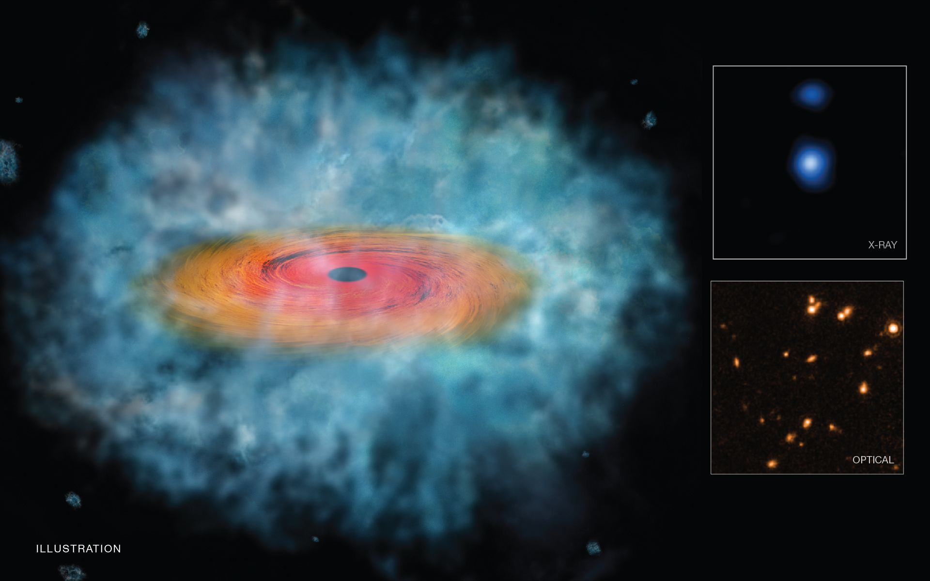
DETECTION
The First DCBH Candidates
Credit: X-ray: NASA/CXC/Scuola Normale Superiore/Pacucci, F. et al, Optical: NASA/STScI; Illustration: NASA/CXC/M.Weiss
Notes:
This is the illustration prepared for the NASA press release, about the formation process for a DCBH. On the right, you can see the infrared and X-ray images of one of our two sources.

Slide 36
DETECTION
Status of Black Hole Seeds Searches
SURVEYS
Photometric selection
Two DCBH candidates in
GOODS-S at z>6
(Pacucci et al., 2016)
DCBH candidate at z = 6.06
SINGLE SOURCES
Pop III stars
DCBH
  The case of CR7 (LAE at z=6.6)
(e.g. Sobral et al., 2015):
  No metal lines
  Strong Lya and He II lines
  (but see Shibuya et al., 2017)
Notes:
The second category of DCBH searches is a specific analysis of single sources, with peculiar emission properties. These sources need to have at least some spectral information. I will present you the case of CR7, a very bright Lyman alpha emitter at z=6.6. Sobral and collaborators proposed that the peculiar observational features of CR7 (absence of metal lines and strong Lya and He II emission) may be explained by a burst of Pop III stellar formation inside the source, while we proposed that they might be well explained also by a DCBH active at the center of the source.

Slide 37
DETECTION
The Nature of CR7: a Persisting Puzzle
The photometry of CR7 can be fitted by our DCBH model.
(Pacucci et al., 2017)
Notes:
We performed the same study allowing the metallicity of the gas to be higher than zero, in our low metallicity model. In this case, due to the presence of metal emission lines, the observed photometry is reproduced with a even higher accuracy, within to 1 sigma.

Slide 38
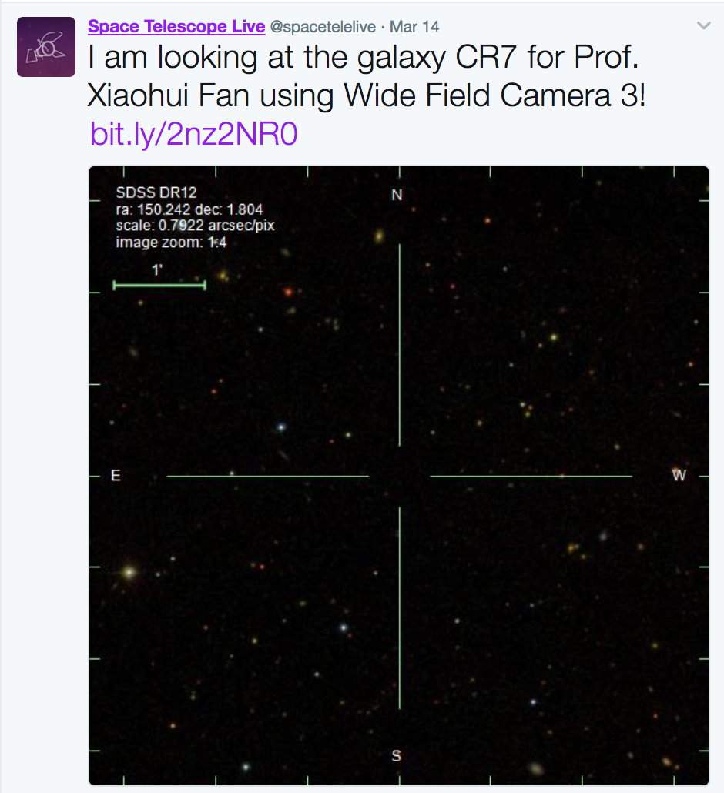
DETECTION
CR7: a Variability Study with Hubble
UV variability would favor
the black hole interpretation.
Cycle 24 HST observation
PI: Xiaohui Fan
Predictions
  Predicted variability of CR7: 0.15-0.2 mag in rest-frame UV
  Short (one month) and long (one year) term rest-frame variability
Observations
  Deep F110W and F160W exposures of CR7
  Observations separated by 300 days (40 days rest-frame)
Notes:
As the study that I just presented suggested, photometric observations cannot rule out any hypothesis on the nature of CR7. While a spectrum of this source will likely provide a definite answer, there is another viable path: a study on the possible variability of this source. The detection of a variability on the month or year time scale would favor the black hole interpretation, since stellar populations cannot change so rapidly. With Xiaouhi we obtained 4 orbits with the HST, separated by about 300 days (40 days in the rest frame of CR7). This, coupled with an additional observation in 2012, could provide answers on the possible monthly and annual variability. Our prediction for a black hole of the mass of CR7 is an rms variability of 0.15-0.2 magnitudes in the rest frame UV. The first observation happened one week ago, while the secondo one is scheduled for the end of the year. So CR7 might reserve us some surprises even before the coming online of the JWST.

Slide 39
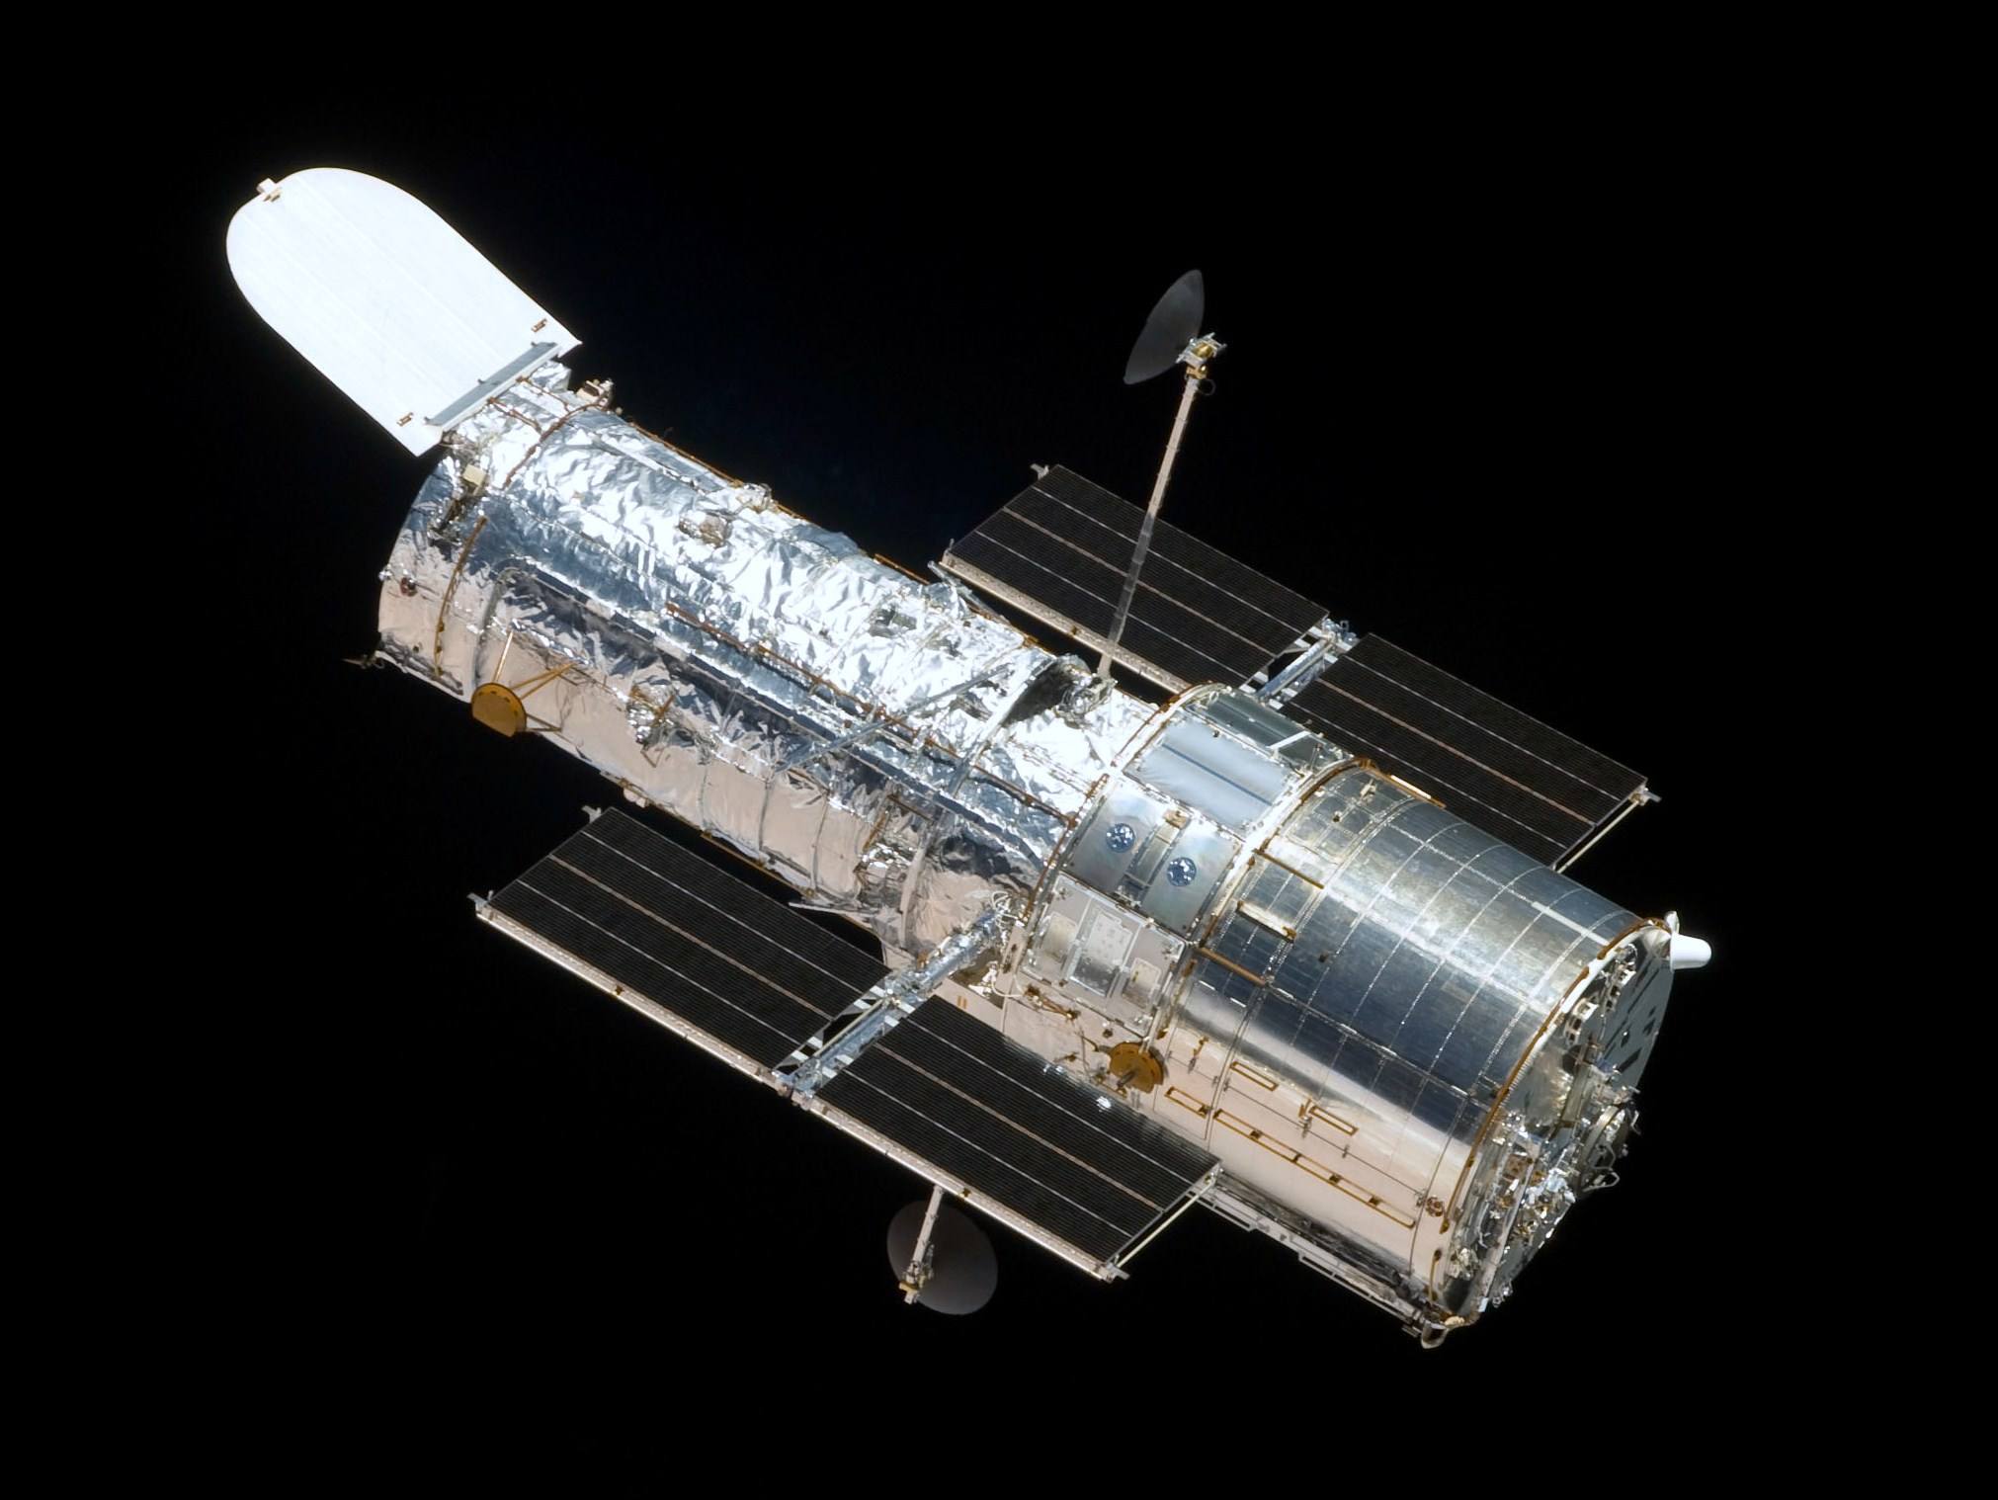
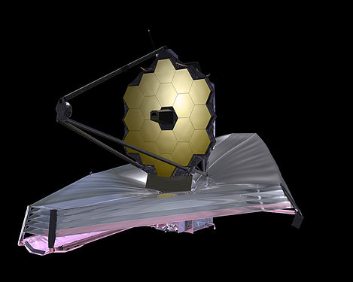
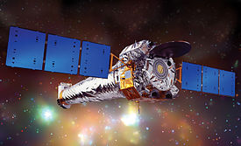
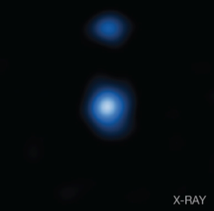
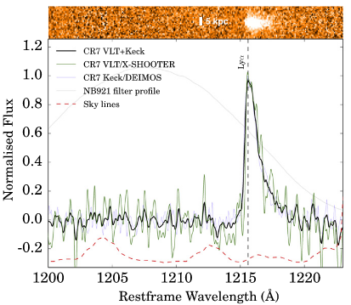

DETECTION
The Black Hole Hunters
HST
Chandra
JWST
Notes:
As a final remark, I want to introduce you to the black hole hunters. The Hubble Space Telescope, the JWST, the Chandra X-ray Telescope, among the others, will play a key role in the search for the first black holes formed in the Universe. Each of these telescopes is unique in its proper way and they can detect different manifestations of the phenomenon we are looking for. All these amazing instruments, anyway, have a common uniqueness: the passion, the hard work and the commitment of hundreds of astronomers all around the world. Thank you.

Slide 40


